Slide 1
Improving Procurement, One Conversation at a Time

Slide 2
Learning Objectives
Compare and contrast bid processes of large and small operators
Showcase different strategies for procurement
Identify how to improve the procurement process

Slide 3
Method
Interflex has gathered information on the procurement process from operators nationwide via:
telephone interviews
online surveys
bid opportunity and award data.
Operators with enrollment size of > 13,000 students were designated ‘Large’ versus ‘Small’
This information has been analyzed and the findings are presented here for discussion.

Slide 4
Topic 1 Vendors & Product Information

Slide 5
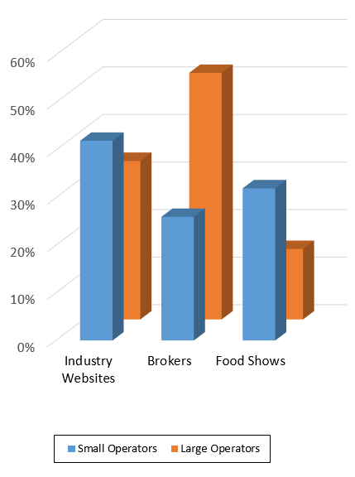
How are you finding existing product information?
Other Methods Include:
Directly from the Vendor
Sales Visits
Gathered through a Cooperative
Challenges:
Finding accurate product information
Too time-intensive to find information
Vendors not carrying the desired products – resulting in special orders

Slide 6
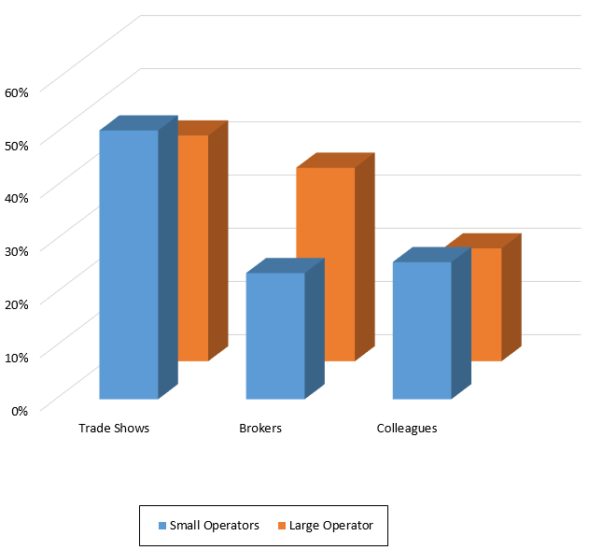
How are you finding new product information?
Other Methods Include:
Trade Publications
Email Blasts
Directly from the Vendor
Challenges:
Vendors not carrying desired products in certain areas

Slide 7
How are you notified of discontinued or reformulated products?

Slide 8
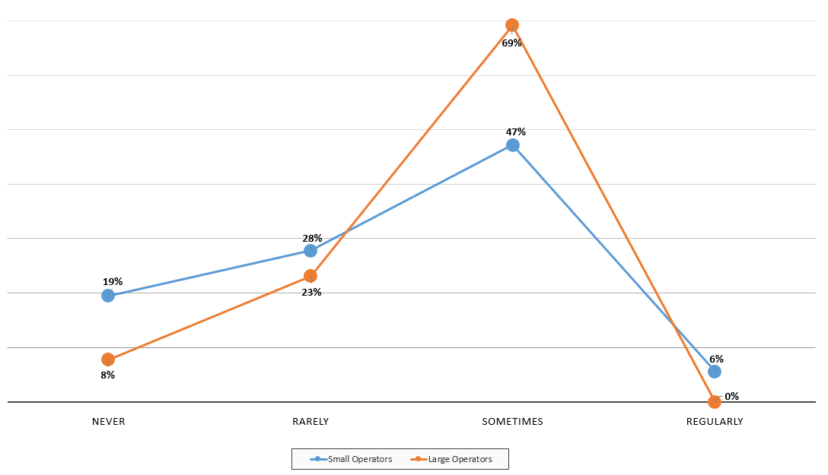
How often are you notified of discontinued or reformulated products?

Slide 9
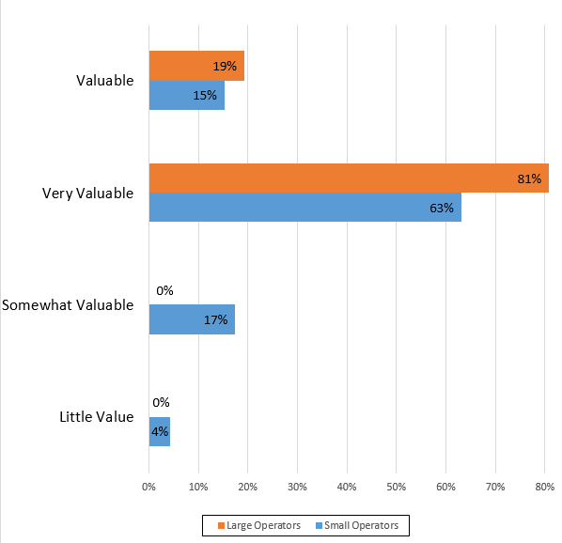
How valuable are your interactions with brokers, distributors, & manufacturer sales reps in regards to finding product info?
Based on those with the best knowledge of product information and availability, about 50% of respondents stated they prefer to work with all industry partners:
Manufacturers
Distributors
Brokers
REASONS FOR COMMUNICATION:
Most timely / accurate response
To build successful relationships & trust with partners

Slide 10
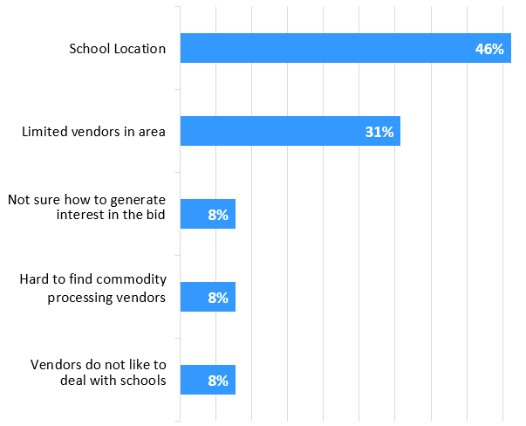
Do you have trouble finding new vendors?
If yes, why do you think this is?

Slide 11
Vendors & Product Information Challenges
Finding vendors that will divert products for commodity
Short notice of product changes could have larger effects
Allergens
Extra stocking / space required
Certain vendors are limited by region
Bread and Bakery Items
Milk and Dairy Items
Increased regulations forcing manufacturers to leave K12

Slide 12
Vendors & Product Information Best Practices
Bring accurate product info to meetings
CN Labels, PFS, Availability, etc.
Talk to other districts about with whom they work
Communicate with all members of the supply chain
Use appropriate channels of communication, (i.e. phone calls, emails, scheduled meetings)
Time is of the essence – work out a schedule that works for everyone
Be aware that alternate or replacement items may require special orders

Slide 13
Topic 2 Forecasting Quantities

Slide 14
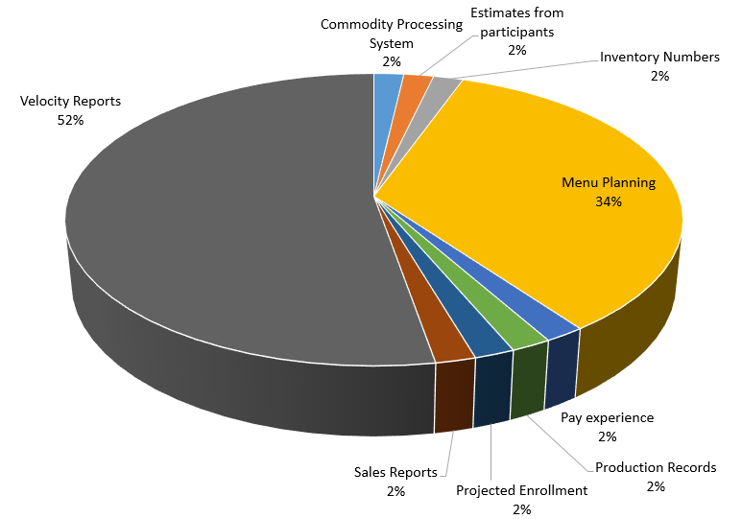
How do you come up with forecast quantities?

Slide 15
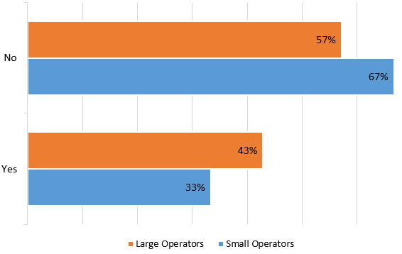
Would you ever provide a forecast of zero?
Of those who list zero, reasons why include:
Difficult to forecast for new products
Bidding two or more similar products

Slide 16
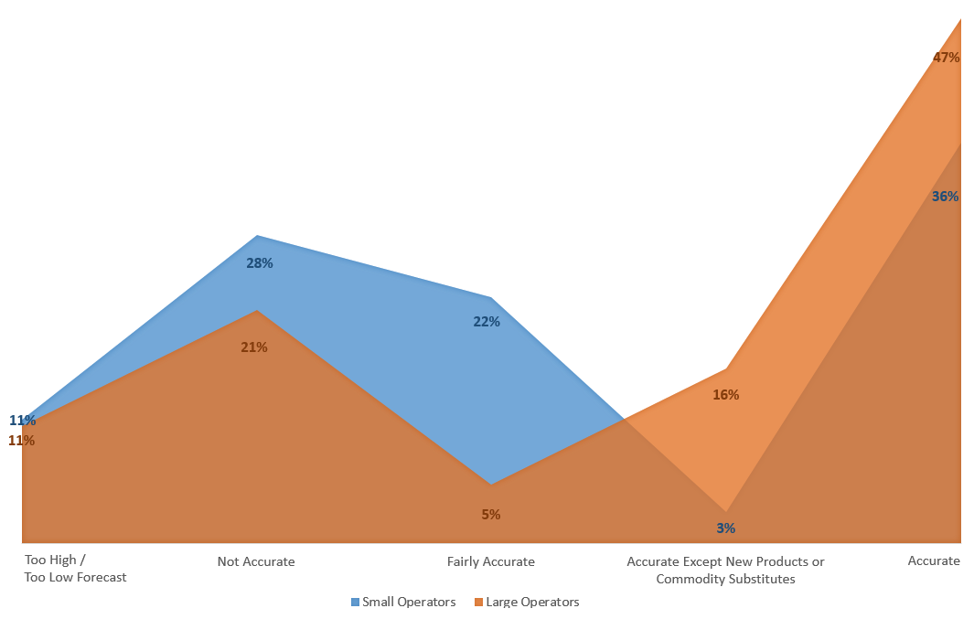
How accurate are your forecasts?

Slide 17
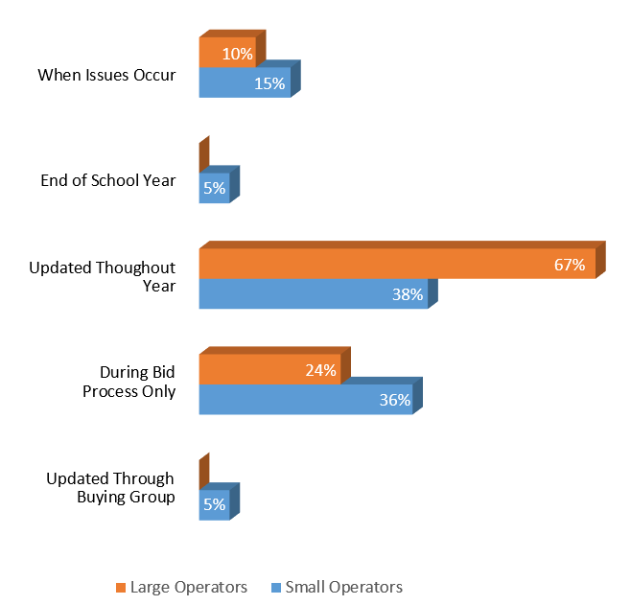
When are forecasts updated throughout the year?

Slide 18
Forecasting Quantities Challenges
Student preference significantly affects usage
Difficult to plan for upcoming year
If item isn’t delivered on time it affects usage numbers / storage space
Menu changes
Hard to forecast for Smart Snacks items, find variety kids will eat
Commodity variables

Slide 19
Forecasting Quantities Best Practices
Monitor forecasts throughout year
Menus drive forecasting/ordering
Use ADP formula to help forecast:
servings/case x ADP x # of days on the menu
For new products, use similar items & menu cycles from past experience
Communicate changes

Slide 20
Topic 3 Communication with Vendors

Slide 21
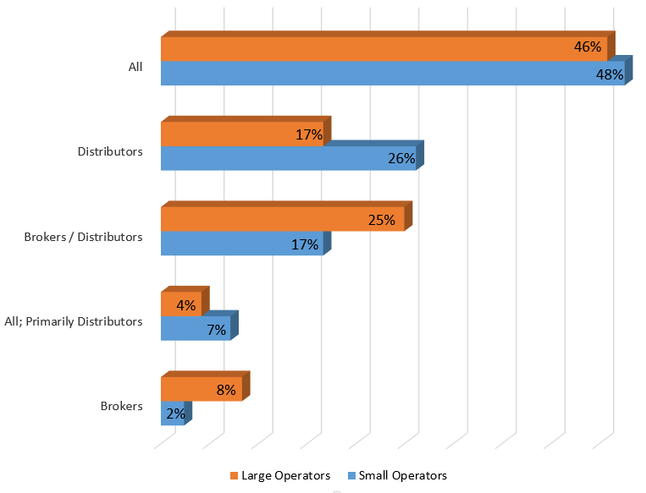
Which supply chain partner do you communicate with most?

Slide 22
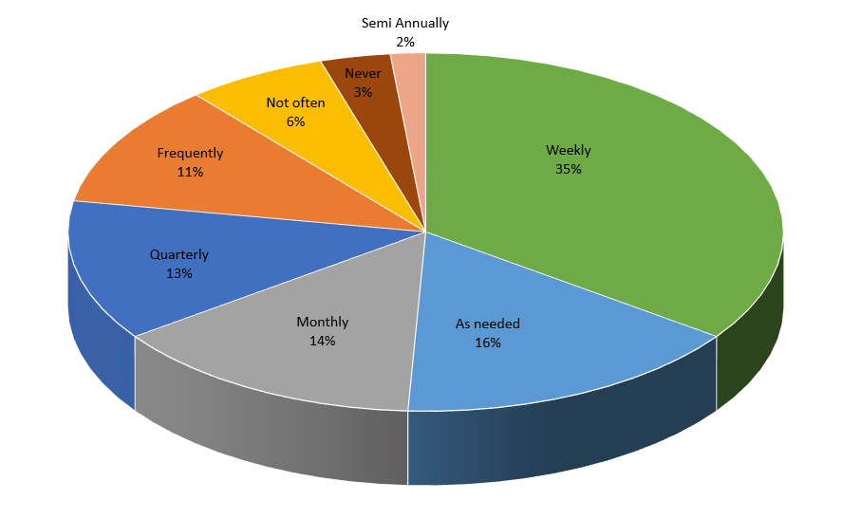
How often do you communicate with vendors?

Slide 23
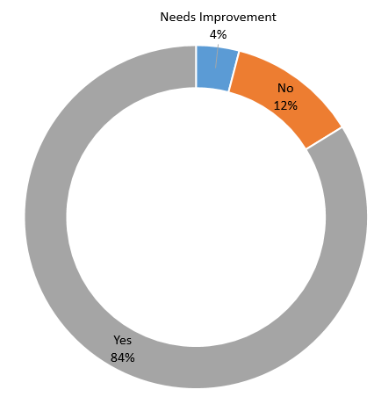
Do you feel the communication that does happen is sufficient?
Yes…
No…
Vendors are very helpful gathering and providing info
Very timely, usually responds within the same day
Difficult to get info required by state
Want to hear more feedback
Frustrated when there is variance between info provided and product received
Not notified about new products

Slide 24
Communication with Vendors Challenges
Consistent communication of product changes or shortages
Response time on certain issues

Slide 25
Communication with Vendors Best Practices
Be responsive to voice messages / emails received
Communicate with everyone – distributor, broker, and manufacturer – when possible
Have a good working relationship with your vendors

Slide 26
Topic 4 Evaluating & Awarding Bids

Slide 27
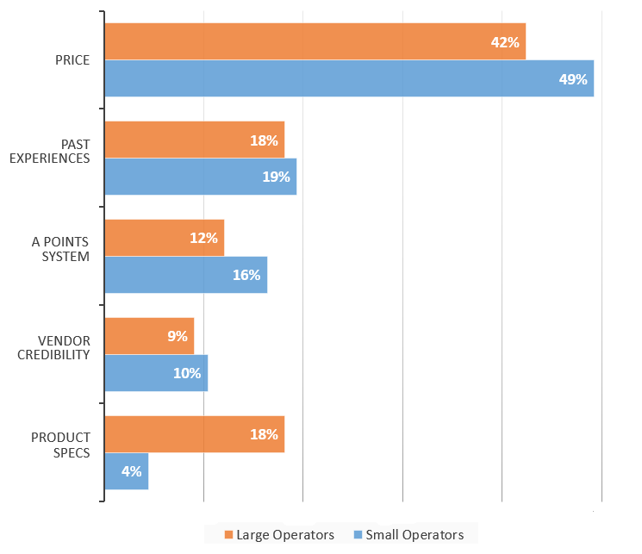
What criteria do you use to evaluate & award your bid?

Slide 28
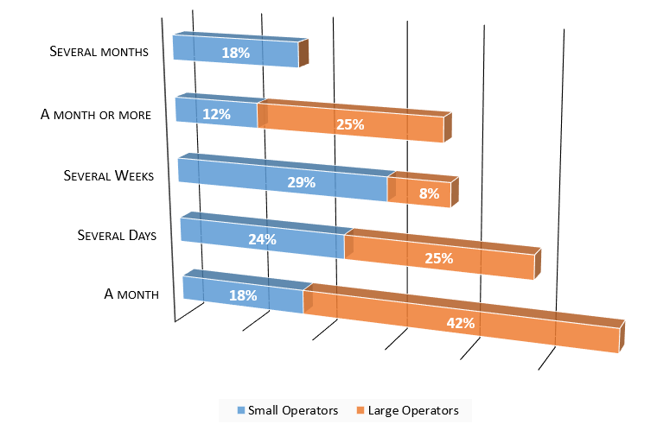
How long does the evaluation process take?

Slide 29
Who do you notify of the bid award and what information do you provide?

Slide 30
Evaluating & Awarding Bids Challenges
Vendors not providing all/correct product information
Establishing a points system for evaluation
Evaluating a new vendor
Comparing varying pack sizes
Responsiveness of vendors
When items awarded are no longer available

Slide 31
Evaluating & Awarding Bids Best Practices
Keep a record of your process, why or why not particular items were awarded
Issue award information in a timely manner
4 – 6 weeks lead time to ensure availability of product
Communicate and collaborate before making changes

Slide 32
Questions & More Information
Resources Sheet – additional information
Contact Card – fill out and return if you would like to participate in future discussions on procurement with Interflex
Any questions

Slide 33
Professional Standards Code
This session provides one (1) CEU
Key Area: Operations - 2000
Key Topic: Improving Procurement One Conversation at a Time - 2420

