Slide 1
Improving Procurement: A Case Study
by Interflex, Inc.
Topic 1: Vendors & Product Information …………... p. 3
Topic 2: Forecasting Quantities ………………………… p. 15
Topic 3: Communication with Vendors …………..…. p. 23
Topic 4: Evaluating & Awarding the Bid …………….. p. 31

Slide 2
Method
Interflex has gathered information on the procurement process from operators nationwide via telephone interviews, online surveys, and bid opportunity and award data.
Four separate online surveys (one for each topic) were distributed to schools across the country. The number of respondents varied by survey. The average number of responses is 70.
Interflex also interviewed four operators (2 small schools and 2 large cooperatives) via telephone.
This information has been analyzed and the findings are presented here for discussion.
*Note: operators with an enrollment size of >13,000 students were designated as “large” and those with an enrollment size <13,000 were designated as “small”.

Slide 3
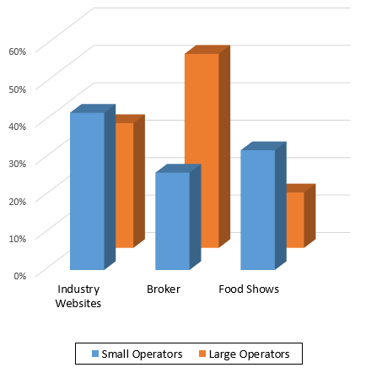
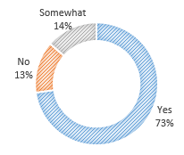
Topic 1: Vendors & Product Information
How do you find the majority of your product information?
Are you satisfied with the information?
  Other Methods Include:
  Directly from the Vendor
  Sales Visits
  Gathered through a Cooperative

Slide 4
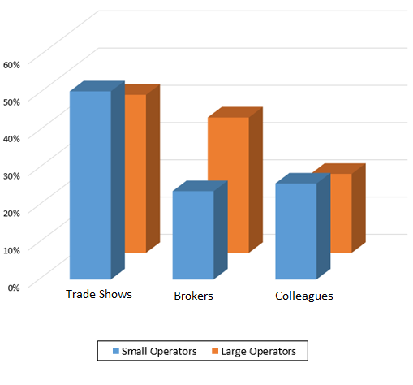
Topic 1: Vendors & Product Information
How do you hear about new products that are available?
Other Methods Include:
  Trade Publications
  Email Blasts
  Directly from the Vendor

Slide 5
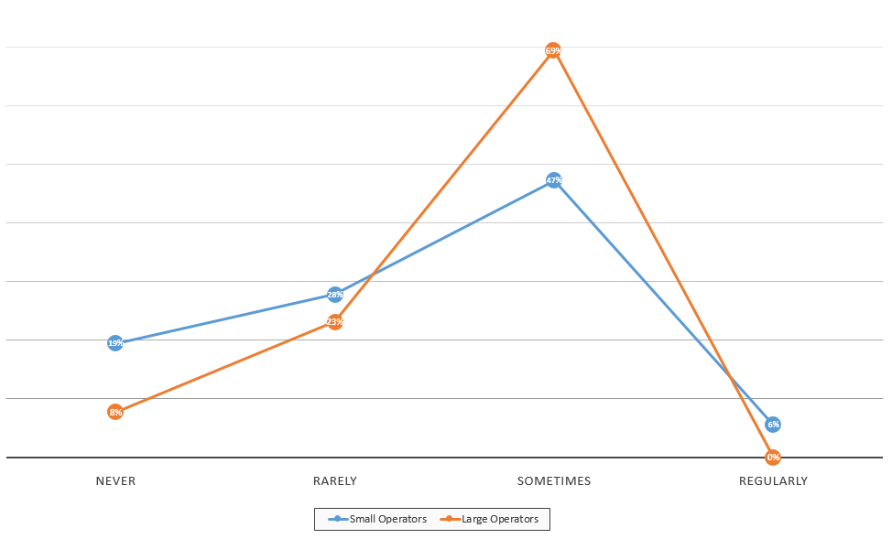
Topic 1: Vendors & Product Information
How often are you notified of discontinued or reformulated products?
Of those notified, 75% heard through Distributors, Email or Brokers.

Slide 6
Topic 1: Vendors & Product Information
When products are discontinued are replacement products recommended to you?

Slide 7
Topic 1: Vendors & Product Information
Do you actively check for product changes throughout the year?

Slide 8
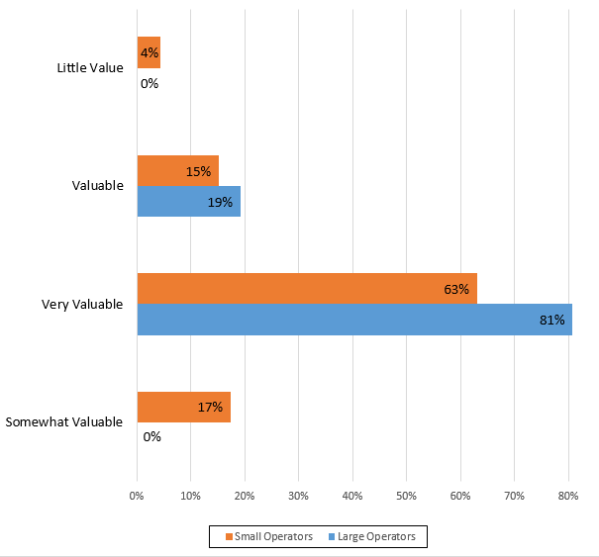
Topic 1: Vendors & Product Information
How valuable are your interactions with brokers, distributors, and manufacturer sales reps in regards to finding product information? Do you prefer to be contacted more by brokers, distributors, or manufacturers? Why?
About 50% of respondents stated they prefer to work with all industry partners:
  Manufacturers
  Distributors
  Brokers
Based on those with the best knowledge of product information and availability.

Slide 9
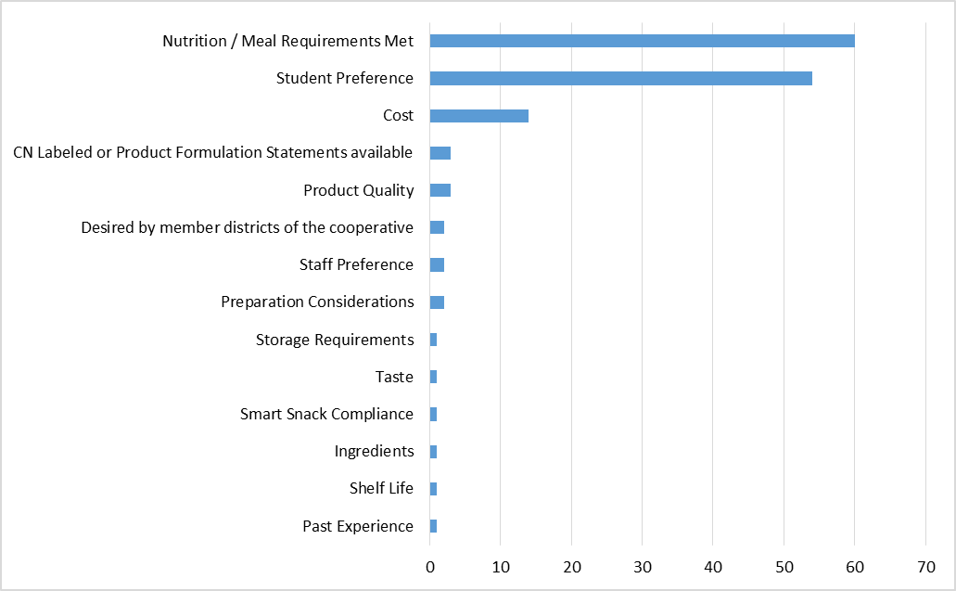
Topic 1: Vendors & Product Information
What is the primary reason that you list a product as approved on a specification?

Slide 10
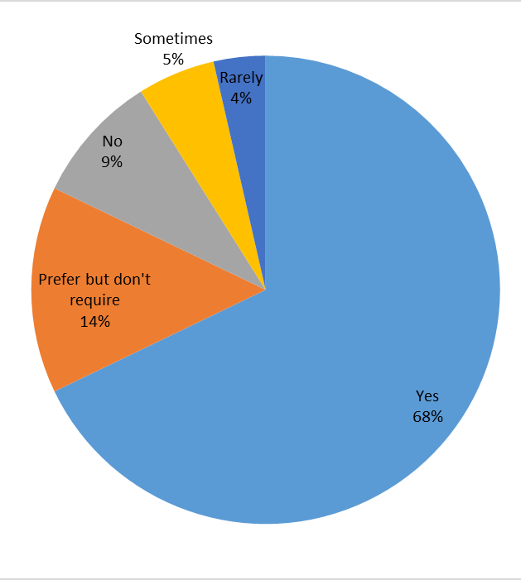
Topic 1: Vendors & Product Information
Do you require samples of non-approved products?

Slide 11
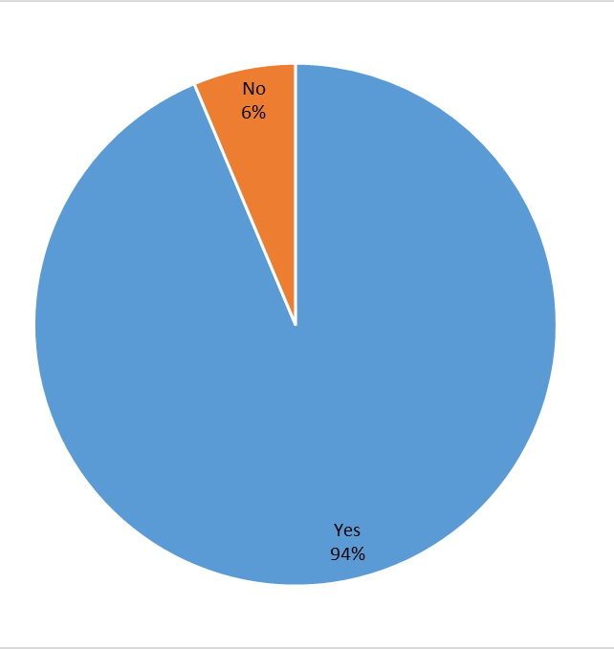
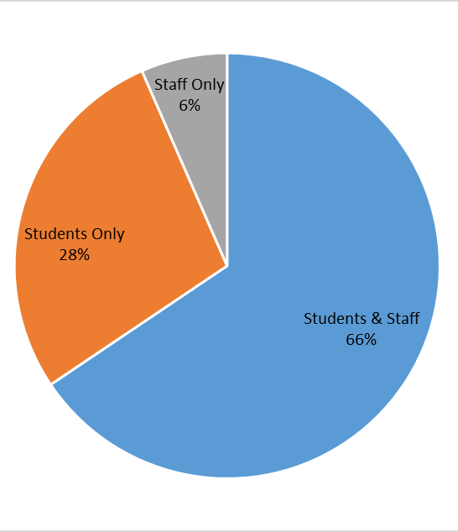
Topic 1: Vendors & Product Information
Do you have taste-tests? Who is tasting the product?

Slide 12
Topic 1: Vendors & Product Information
How are products rated during taste tests?

Slide 13
Topic 1: Vendors & Product Information
Are you satisfied with the number of vendors currently participating on your bids?
If not, how do you find new vendors and contacts?
Contacting brokers or manufacturers to see which distributors stock those items
Eligible vendors are notified of the bid
The bid is posted electronically.
Trade Shows
Vendors contact the school directly
Word of mouth

Slide 14
Topic 1: Vendors & Product Information
Do you have trouble finding new vendors? If yes, why do think this is?

Slide 15
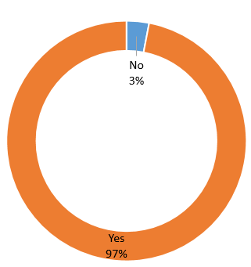
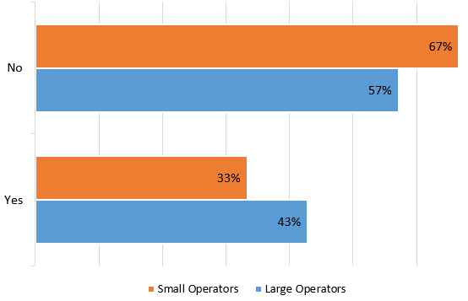
Topic 2: Forecasting Quantities
Do you provide quantities on your bid?
Would you ever list a zero and why?
Of those who list zero, reasons why include:
Difficult to forecast for new products
Bidding two or more similar products

Slide 16
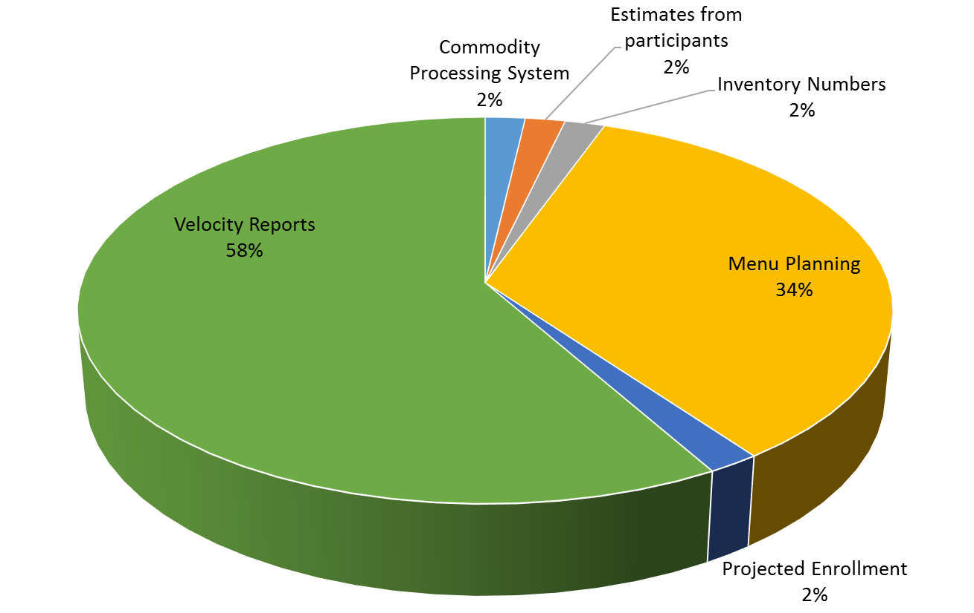
Topic 2: Forecasting Quantities
How do you come up with your forecasts? What obstacles do you encounter?
Obstacles include:
Student preference significantly affects usage
Difficult to plan for upcoming year
If item isn’t delivered on time, affects usage numbers / storage space
Menu Changes
Hard to forecast for Smart Snacks items, find variety kids will eat

Slide 17
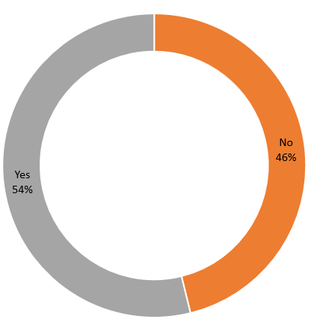
Topic 2: Forecasting Quantities
Do you use a menu-planning software? If yes, which software?

Slide 18
Topic 2: Forecasting Quantities
Is your menu-planning software helpful when forecasting quantities?
If you use cycle menus, what is the cycle length?

Slide 19
Topic 2: Forecasting Quantities
How do you forecast for a new product?

Slide 20
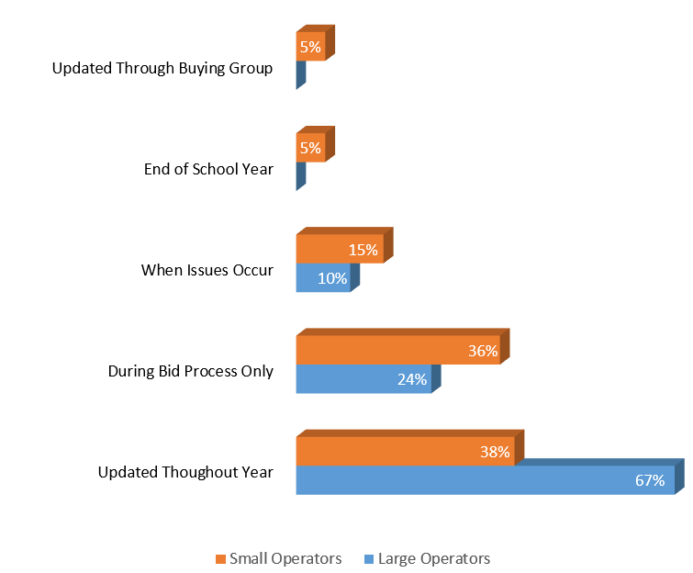
Topic 2: Forecasting Quantities
When do you update your forecasts?

Slide 21
Topic 2: Forecasting Quantities
How accurate do your forecasted quantities usually turn out to be compared to what you actually purchase that year?

Slide 22
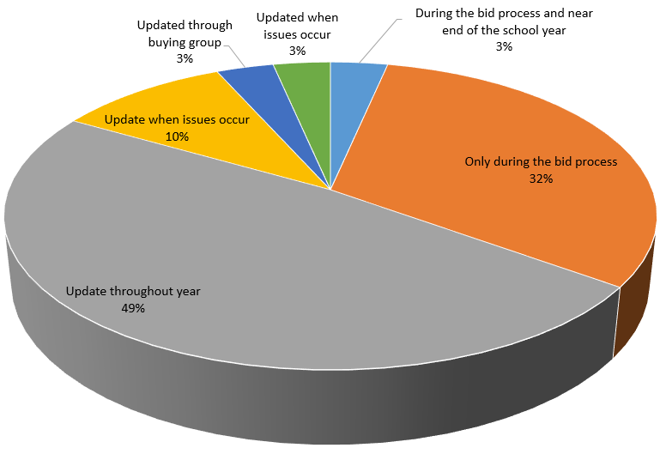
Topic 2: Forecasting Quantities
Is the forecasted quantity on your bid the only time that you communicate forecasts with your vendors or do you update them throughout the year?

Slide 23
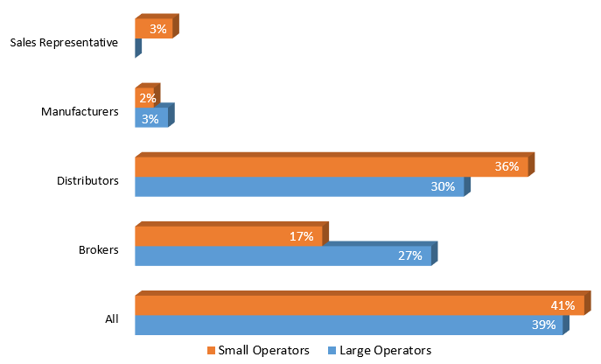
Topic 3: Communication with Vendors
Do you communicate mostly with brokers, distributors, manufacturers, or a combination?

Slide 24
Topic 3: Communication with Vendors
Are you in communication with vendors besides those from whom you purchase?
How do you hear about potential vendors in your area?

Slide 25
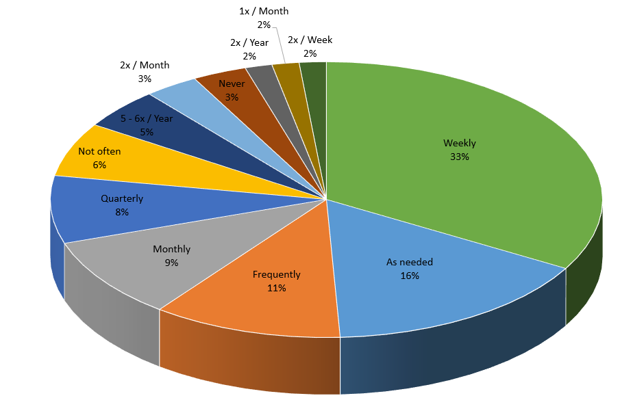
Topic 3: Communication with Vendors
How often do you communicate with your vendors?

Slide 26
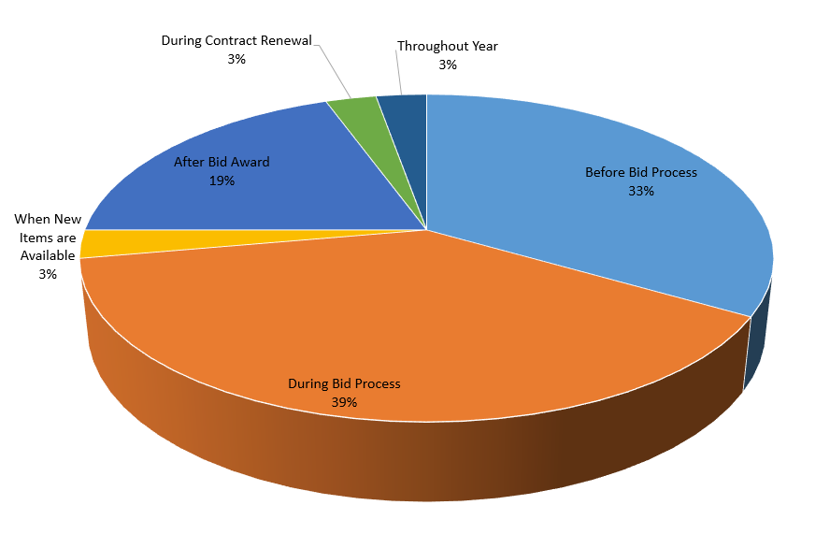
Topic 3: Communication with Vendors
Does the frequency of communication vary over the bid process? When is it most prevalent?

Slide 27
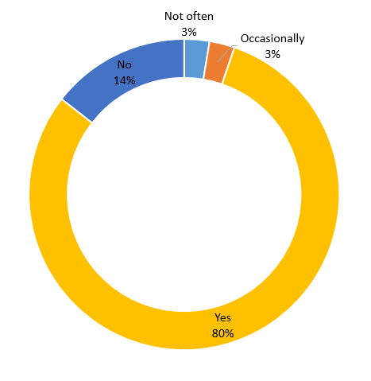
Topic 3: Communication with Vendors
Do you ever get onsite visits from your vendors, not including deliveries?

Slide 28
Topic 3: Communication with Vendors
Do you hold any meetings with your vendors? Are they optional or mandatory?

Slide 29
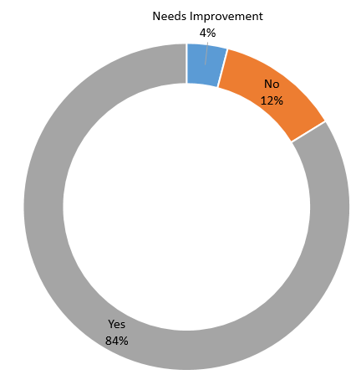
Topic 3: Communication with Vendors
Do you feel that the communication happening is sufficient? Why or why not?
Reasons stated for Insufficient communication:
Lack of time
Location of trading partners
Reasons stated for Sufficient communication:
Issues resolved quickly
Regular visits
Getting the information needed

Slide 30
Topic 3: Communication with Vendors
Do you feel your vendors are responsive when issues arise? If not, how can this be improved?

Slide 31
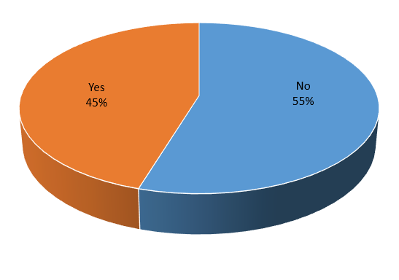
Topic 4: Evaluating & Awarding the Bid
Are the vendors usually present when you do your bid opening?

Slide 32
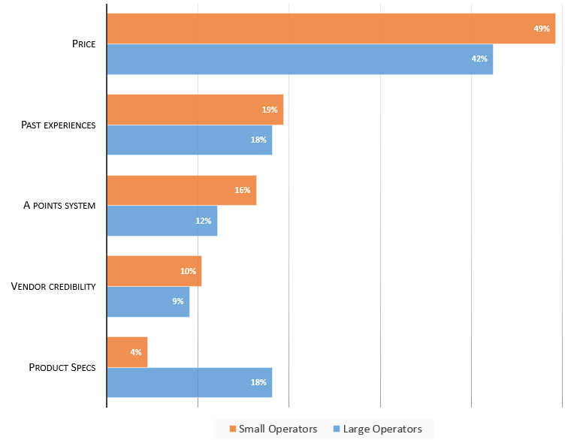
Topic 4: Evaluating & Awarding the Bid
What criteria do you use to evaluate and award your bid?

Slide 33
Topic 4: Evaluating & Awarding the Bid
What challenges do you face when evaluating the bid?
Establishing the points system on which evaluation will be based
Past negative experiences with a particular vendor.
Evaluating a new vendor is a challenge.
Verifying that the vendors have bid the correct product.
Vendors bidding something other than what was specified on the bid.
Knowing the equality of the products/brands
When the lowest bidder is not the most reliable bidder.
Making sure all products are comparable
Vendors bidding pack sizes different than what was specified on the bid.
Vendors meeting the schools requirements
Having the correct product
Vendors not bidding on every item
Vendors not understanding the RFP Criteria
Responsiveness of vendors
When an alternate item is bid without product information
School attitudes about vendors
When vendors don't follow the bid specs and the school has to convert everything to be comparable.
The print being too small
Trying to stay local

Slide 34
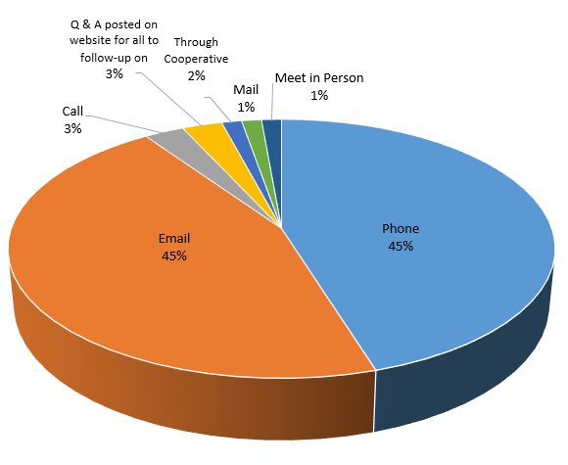
Topic 4: Evaluating & Awarding the Bid
How do you reach out to distributors when you have questions about their quotes? Are the distributors receptive to your inquiries?
93% respondents say the vendors are always receptive. The other 7% said they are receptive after a follow-up.

Slide 35
Topic 4: Evaluating & Awarding the Bid
Is there a group or specific department that handles awarding bids, or do you make recommendations for the school board?

Slide 36
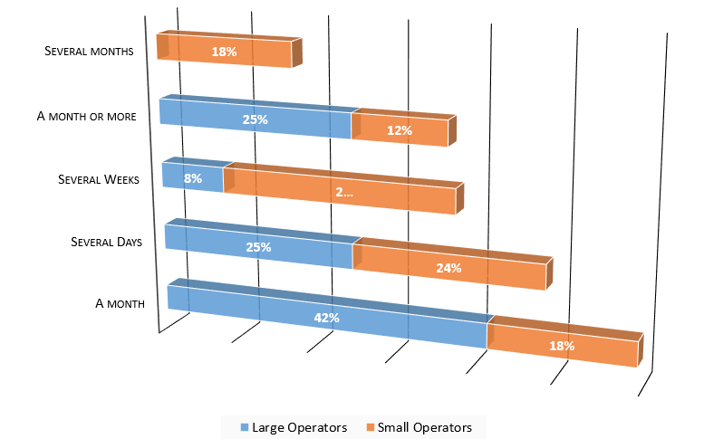
Topic 4: Evaluating & Awarding the Bid
How long does the evaluation process take?

Slide 37
Topic 4: Evaluating & Awarding the Bid
How much time do you allow between awarding the bid and placing your first order?

Slide 38
Topic 4: Evaluating & Awarding the Bid
Who do you notify (if anyone) of the award?

Slide 39
Topic 4: Evaluating & Awarding the Bid
What information do you provide (e.g. only winning quotes, all quotes, etc.)?

Slide 40
Topic 4: Evaluating & Awarding the Bid
How do you notify your vendors of the award results?

